Slide 1
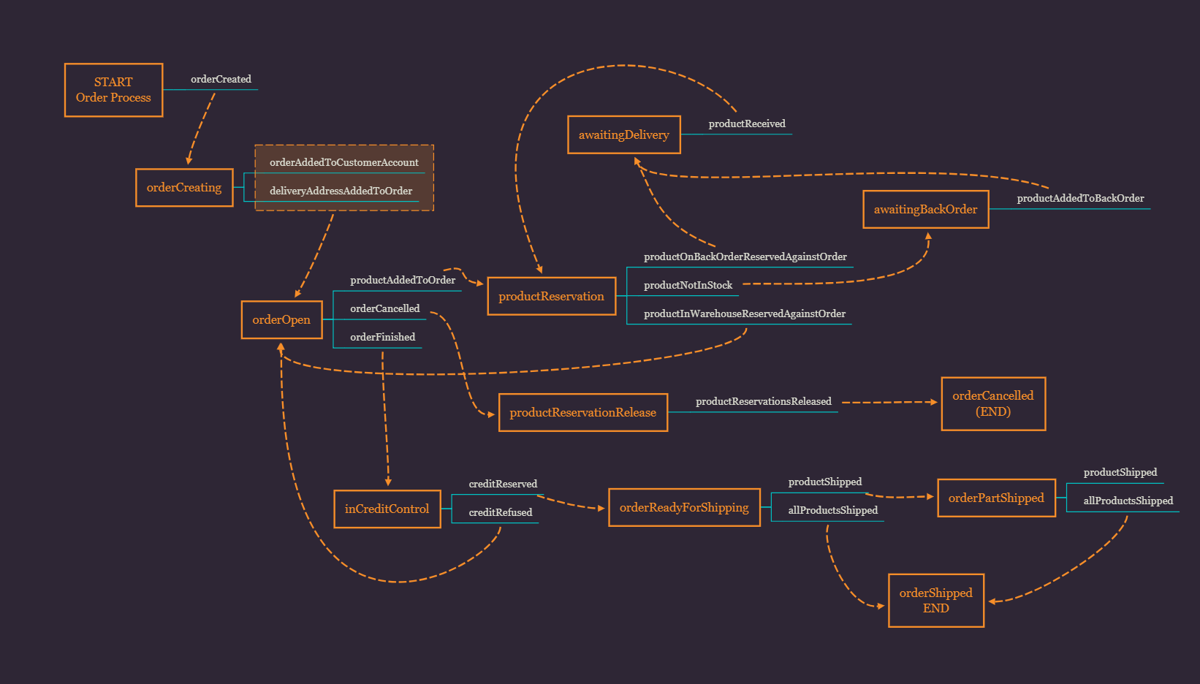

Event Sourcing in a Microservices Environment
What I learnt (so far)
2019 Daniel Wagstaff

Slide 2
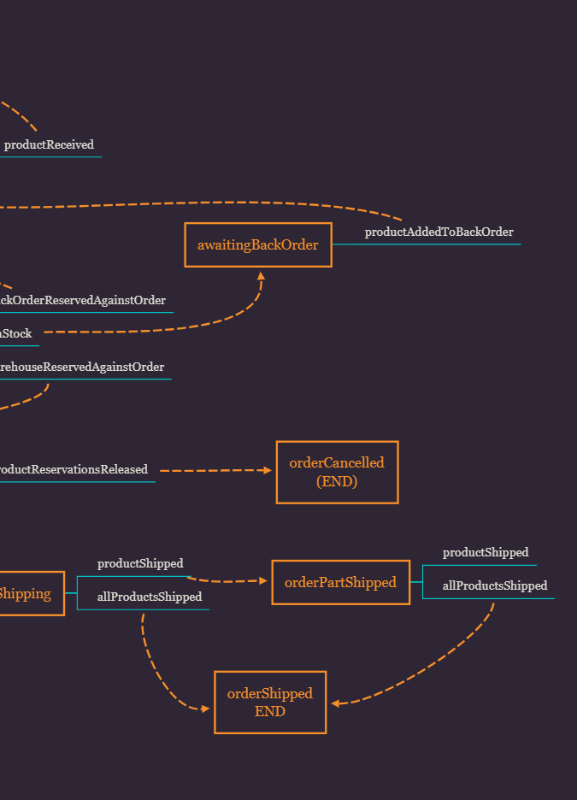

Contents
CQRS, Event Sourcing & Architecture
  CQRS Recap
  Event Sourcing
  Likely Architecture
Example Project: “Triad Delivers”
  Design & “Event Storming”
  Architecture
  A Note on the Technologies
  What’s Next?
  Demonstration

Slide 3
CQRS, Event Sourcing & Architecture
CQRS Recap

Slide 4




CQRS
Recap
Resource
Service
Domain Class
Repository
Notes:
Domain classes are often used between multiple services and multiple architectural layers

Slide 5
CQRS
Recap
Resource
Hard to change
Service
Domain Class
Repository
Notes:
However, they are hard to change, as any change may impact multiple layers
They are also often common to both the write and the read operations

Slide 6
CQRS
Recap
Resource
Hard to change
Service
Liable to bloat
Domain Class
Repository
Notes:
Which makes them liable to either memory bloat or processing bloat.
Often, in simple, CRUD systems, a single representation is exactly what we need, when we are concerned with retrieving and updating a record structure.
However, in more complex systems:
Memory and transport bloat
Often a read operation might only want to query a subset of the full domain model,
but it has to retrieve the full model from the database and through the transport protocol (often HTTP)
Processing Bloat
we may want to look at the information differently from how it’s stored – perhaps by collapsing multiple records into one, or by creating virtual records by combining information from multiple places
or, updating might require validation rules that only allow certain combinations of data to be stored, or may infer data to be stored from the provided data
When this happens, we start to see multiple representations of the data, but they are often still resolved down to a single representation for storage
Reducing down to the same conceptual model to serve all purposes can lead to a complex model that serves neither well

Slide 7

CQRS
Recap
Read
Resource
Write
Resource
Service
Service
Read
Models
Write
Models
Repository
Repository
Notes:
CQRS splits that conceptual model into separate models for update and display (command & query)
A web example would see a user looking at a web page that's rendered using the query model. If they initiate a change that change is routed to the separate command model for processing, the resulting change is communicated to the query model to render the updated state.
Having separate write/read models allows running in separate processes and even on separate hardware, which facilitates scaling:
if querying has a lot of traffic, can increase number of Read Services – can even scale by specific Read models
CQRS models may share the same database, in which case the database acts as the communication between the two models.

Slide 8
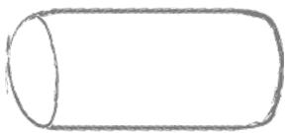
CQRS
Recap
Read
Resource
Write
Resource
Service
Service
Read
Models
Write
Models
Repository
Repository
Notes:
Otherwise, the read and write sides may use separate databases
So, there needs to be some communication mechanism between the two models or their databases.
But, now we have to compensate for the fact that our system becomes eventually consistent
Now, we have extra development effort to compensate
And, it’s a significant mental leap from simple CRUD to CQRS - it’s been done very badly many times
CQRS needs to be worth the expense and it should be applied to the correct problem.
It’s often the wrong solution, but circumstances in which it could be considered are:
where performance needs to be gained by scaling read and writes separately
event-based systems

Slide 9
CQRS, Event Sourcing & Architecture
Event Sourcing

Slide 10
Event Sourcing
Storing Events
BankAccount
Customer
Balance
Notes:
Often, data is modelled according to the nouns of a system – for example, a bank account may be concerned with Customer and Balance
But, this is likely to be too simplistic, as most of us care about how our balance got to be what it is

Slide 11
Event Sourcing
Storing Events
AccountSuspended
6
FineRevoked
5
SuspiciousActivityDetected
4
FinedForGoingOverdrawn
3
BankAccount
Customer
Balance
WithdrewCashByContactless
2
WithdrewCashByChipAndPin
1
Notes:
Event Sourcing seeks not to store the nouns of the system, but the actions of a system.

Slide 12
Event Sourcing
Storing Events
AccountSuspended
6
FineRevoked
5
Accounts Suspected of Fraud
SuspiciousActivityDetected
4
FinedForGoingOverdrawn
3
BankAccount
Customer
Balance
Suspended Accounts
WithdrewCashByContactless
2
Balance
WithdrewCashByChipAndPin
1
Notes:
The read side now must interpret the stored Events to create Views.
Can have multiple views, which are only interested in their own events.

Slide 13

Event Sourcing
Command & Event Modelling
AccountSuspended
6
FineRevoked
5
Accounts Suspected of Fraud
SuspiciousActivityDetected
4
FinedForGoingOverdrawn
3
BankAccount
Customer
Balance
Suspended Accounts
WithdrewCashByContactless
2
SuspendForFraud
Balance
WithdrewCashByChipAndPin
1
Withdraw
Notes:
Events don’t happen without an external input: a command
Notice:
Events are in the past: the thing has happened
Commands are a request: depending on the state of the model, they may not be enacted
Commands are Queries are inherently different – as such, Event Sourcing requires Event Sourcing by definition

Slide 14


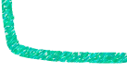
Event Sourcing
Command & Event Modelling
AccountSuspended
FineRevoked
SuspendForFraud
SuspiciousActivityDetected
FinedForGoingOverdrawn
Withdraw
WithdrewCashByContactless
WithdrewCashByChipAndPin
Notes:
Commands can trigger just one event, but they often trigger multiple
In this example, the 2nd withdrawal sends the account overdrawn, which triggers another event: the fine
An external process, which is likely monitoring the events for the account, detects suspected fraud and so sends the command to suspend the account, which triggers the chain of events:
Suspicious activity detected
Fine revoked
Account Suspended

Slide 15


Event Sourcing
Command & Event Modelling
Customer View
Clerk
View
AccountSuspended
FineRevoked
SuspendForFraud
SuspiciousActivityDetected
FinedForGoingOverdrawn
Withdraw
WithdrewCashByContactless
WithdrewCashByChipAndPin
Notes:
A customer may be unlikely to see the mistakenly applied fines, just the suspicious withdrawals and the fact that his or her account has been suspended.
Whereas, a bank clerk may see all the events
As the Views are responsible for interpreting the Event stream, infinitely flexible View models can be created. But, obviously at extra development cost.

Slide 16
CQRS, Event Sourcing & Architecture
Likely Architecture

Slide 17
Likely Architecture
Read/Write Models
Read
*
Command Handler
1
Command
1
1
*
Aggregate Root
1
Event
*
View
*
Write
*
*
1
1
Notes:
Event Sourcing has a typical architecture. Obviously, you can do it how you like, but this is an example used by some of the leaders in the field.
The Aggregate Root is the Domain Model. For example, it could be a bank account.
A Command is received by a Command Handler, which
retrieves the events from the Event Store
creates a blank Aggregate Root, and
applies the events to the Aggregate Root (rehydration)
Now we have a Domain model in the correct state
For the purpose of rehydration, we have to store all aggregate root's events on one stream, so we need a stream that stores AR completely (or multiple ARs).
Could distribute the events across different stores and aggregate them, but this would add development and processing/communication overhead.
The Command Handler now sends the received Command to the hydrated Aggregate Root.
The Aggregate Root handles the Command and creates Events according to its current state – or rejects the command
The new Events are then persisted on the Event Store
It is the Event Store that forms the bridge between Write and Read (or Command and Query)

Slide 18
Likely Architecture
Concurrency
Command
A
Command Handler
Aggregate Root
ID = A001
Event
Aggregate Root
ID = A001
Command
B
Command Handler
Notes:
What do we do if we are in the middle of applying Events from Command A, to A001, when Command B also wants to operate on A001?

Slide 19
Likely Architecture
Concurrency
Command
A
Command Handler
+
E
Aggregate Root
ID = A001
e
e
e
Aggregate Root
ID = A001
Command
B
Command Handler
Notes:
For example,
We have retrieved the Events from the ES and hydrated the AR
We have created a new Event, based on the Command and the state of the AR
But we have not yet applied the new events when…

Slide 20
Likely Architecture
Concurrency
Command
A
Command Handler
e
e
e
Aggregate Root
ID = A001
Aggregate Root
ID = A001
e
e
e
Command
B
Command Handler
Notes:
Command B is received, also for AR A001, which then hydrates another copy of AR001 – the same state before the Events from Command A are applied

Slide 21
Likely Architecture
Concurrency
Command
A
Command Handler
e
e
e
+
E
Aggregate Root
ID = A001
Aggregate Root
ID = A001
e
e
e
Command
B
Command Handler
Notes:
Before Command B is completed, Command A’s NEW events are written back to the Event Store

Slide 22
Likely Architecture
Concurrency
Command
A
Command Handler
e
e
e
Aggregate Root
ID = A001
+
E
X
Aggregate Root
ID = A001
e
e
e
+
E
E
Command
B
Command Handler
Notes:
Now, Command B also generates Events – different Events
But, Command B might have had a different outcome if it had known about the new Event
If the new Events are applied to the Event Store, they might cause the A001 to be in an invalid state.

Slide 23
Likely Architecture
Concurrency
Command
A
Command Handler
e
e
e
Aggregate Root
ID = A001
+
E
Close account
X
Aggregate Root
ID = A001
e
e
e
+
E
E
Command
B
Command Handler
Withdraw
Payment
Notes:
For example:
Might cause an impossible chain of Events (in business logic terms), such as:
Close bank account
Withdraw money from account
Pay special bonus prize to account
One solution is to lock the Event Store, but this is inefficient and might prevent other ARs from being updated.

Slide 24
Likely Architecture
Concurrency
Command
A
Command Handler
p1
p2
p3
e
e
e
Aggregate Root
ID = A001
p4
+
E
X
Aggregate Root
ID = A001
Write if E[0].p == (stream.last.p + 1)
p1
p2
p3
p4
p5
e
e
e
+
E
E
Command
B
Command Handler
Notes:
The most common solution is Optimistic Locking. i.e. the Event Stream for an AR has an incrementing number, and new Events are only applied if the sequence is as expected.
New Events are only written to the Event Store, if the first new Event has an expected position of 1 greater than the last Event in the Store
Optimistic Locking means we don’t prevent other ARs from updates, but it drives the requirement that an AR must be rehydrated, its Commands applied and new Events written to the ES, before the caller can be informed of success – if the caller requires acknowledgement of success/failure of their Command.

Slide 25
Likely Architecture
Summary
unsavedEvent[0].storedPosition == savedEvent[last].storedPosition + 1
alt
else
Command Handler
getById(uuid)
execute(command)
save(aggRoot)
Command
Failed
Aggregate Root Repository
aggRoot
OK
getEvents(uuid)
createAgg()
get: id,
unsavedEvents,
lastStreamPosition
save(unsavedEvents)
Event Store
events
rehydrate(events)
OK
SaveFailed
Aggregate Root
apply(events)
create(events)
apply(events)

Slide 26
Likely Architecture
Getting Started Sooner
unsavedEvent[0].storedPosition == savedEvent[last].storedPosition + 1
alt
else
Command Handler
Event
getById(uuid)
execute(command)
save(aggRoot)
Command
Failed
Aggregate Root Repository
aggRoot
OK
getEvents(uuid)
createAgg()
get: id,
unsavedEvents,
lastStreamPosition
save(unsavedEvents)
Event Store
events
rehydrate(events)
OK
SaveFailed
Aggregate Root
apply(events)
create(events)
apply(events)
Notes:
I found the main components of Event Sourcing to be:
Command Handler
Aggregate Root
Aggregate Root Repository
Event
Event Store

Slide 27
Likely Architecture
Getting Started Sooner
Command Handler
Aggregate Root
Event
+ getId(): UUID
+ rehydrate(List<Event>)
+ getLastStoredStreamPosition(): long
+ getUncommittedChanges(): List<Event>
# applyChange(Event)
+ getAggregateRootId (): UUID
+ getStreamPosition(): long
Aggregate Root Repository
Event Store
+ save(aggregateRoot)
+ findById(UUID): Opt<AggregateRoot>
+ retriveEvents(): List<Event>
+ saveEvents(UUID,
List<Event>, expectedLastStreamPosition)
Notes:
Most of the complex development effort with Event Sourcing comes from handling the Events, uncommitted Events and using reflection to rehydrate the Aggregate
So, I have created a collection of parent classes that can be imported into a project, which deal with that
The project using the parents classes is responsible for:
Passing the Commands to the correct Aggregate Root
Implementing the Event Store – this is likely to be different for every system
Supplying the Event Store to the Aggregate Root Repository
Implementing the method to return the ID from the Aggregate Root
Most of the development effort can now be concentrated on implementing the Aggregate Root methods to:
handle the Commands
raise Events according to the received Commands
Note: Command handlers within the AR only read any AR state, they should never mutate it. Mutation must only be performed by Event handlers, because when rehydrating, we only have the Events, not the Commands

Slide 28
Example Project:
“Triad Delivers”
Design & “Event Storming”

Slide 29
Design & “Event Storming”
The Domain
Order
Product
£
Credit
Shipping
Notes:
Thanks to a recent customer and potential future work, modelling a distribution system seemed like a good idea

Slide 30

Design & “Event Storming”
Forget About the Services
Order
Product
£
Credit
Shipping
Notes:
A system is designed to replicate the process on the ground – although, as part of a new system, a new process may be designed
So, the first thing to do when designing a system is to forget about the services
I imagined the actors and the information that would go between the actors if computers hadn’t been invented
That way, our design decisions will, hopefully, be more useful to the users as they would map the real-world processes, and, as such, be more likely to be able to handle the unexpected requirements

Slide 31

Design & “Event Storming”
Modelling the Communication
Order
Product
£
Credit
Shipping
Notes:
For example: when we ask ourselves, should an Order Complete Event contain the entire order details, or should it just be a flag, which invites others to query?
We might recognise that in real life:
it would be an horrendous bottleneck to have all services (all interested people) querying the order service
Unless, of course, we had an order screen that everyone could come and look at - akin to having specific querying services, but everyone still has to query
Normally, a full order would be sent from the Order department, and Shipping would be interested in most of it, whereas Product and Credit would be interested in their smaller, respective information
This would best lend itself to a pub/sub message model
Our design decisions might also better reflect real boundaries.
For example, all things to do with Credit Control might be better suited to belonging in its own independent service. Having credit controllers looking through an order book to work out what they need to would be unlikely in real life, and so would likely lead to bad design in the virtual world

Slide 32
Triad Delivers
Distribution
Notes:
With that in mind, I created a number of events that I thought would be likely within an order distribution system – now known as “Event Storming”
Regardless of whether or not we are using Event Sourcing, modelling the system by its events helps us to identify its behaviour
It’s more likely to model it accurately than if we started trying to define the data structures first

Slide 33
£
Triad Delivers
Distribution
Notes:
Modelling the Events of the system, four different Microservices became apparent
There are events that are contained within a logical boundary (Microservice) and there are events that are generated by one Microservice that are of interest to other Microservices.
This analysis was done quickly and by myself – in reality, much time should be taken over this and the domain experts consulted.
We should spend time modelling communication between the services on paper to see what information is required between the services – ideally, very little information should be required to be shared between services.

Slide 34
Triad Delivers
Architecture

Slide 35
Architecture
Microservices
Order Read API
Order Write API
Order Complete Process API
Product
API
Order Read Core
Order Write Core
Order Complete Process Core
Product
Core
Cassandra
Notes:
For simplicity, ignoring the Credit Control and Shipping services for the purposes of the demonstration
So we have:
Order Service
Product Service
+ Orchestration Service (implementing the “Saga” pattern – an Orchestration-based Saga, rather than a Choreography-based Saga)

Slide 36

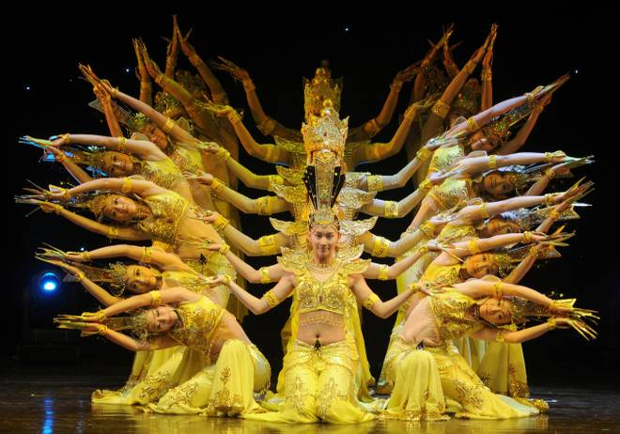
Orchestration
Choreography
Notes:
Note on Orchestration vs. Choreography
Orchestration
Individual services are controlled by a central orchestrator – for example, the violins play when the conductor tells them to
Choreography
Individual services respond to events and messages – in this case, the dancers respond to the music
Orchestration
GOOD: Easier to maintain and manage as we unify the business process at the centre
BAD: Dependencies between services – if one service is down, the process might halt; if the orchestrator is down, the process does not continue
Choreography
GOOD: No dependency on a central controller
GOOD: Easy to add an update individual services, because there is no dependency on a central controller
GOOD: No single point of failure
BAD: Complexity: very difficult to understand the business process, as it is spread among the contributing services

Slide 37
Architecture
Microservices
Order Read API
Order Write API
Order Complete Process API
Product
API
Order Read Core
Order Write Core
Order Complete Process Core
Product
Core
Cassandra
Notes:
I decided to go for Orchestration rather than Choreography because, for the customer in mind, the Order processing logic is liable to change frequently, so maintenance and understanding the process would be easier than if we had to analyse all the different services and how they responded to Events.

Slide 38

Architecture
Event Sourcing is NOT a top-level architecture
Microservices
Order Read API
Order Write API
Order Complete Process API
Product
API
Order Read Core
Order Write Core
Order Complete Process Core
Product
Core
Cassandra
Notes:
I applied Event Sourcing to the Order Service.
One of the biggest mistakes made with Event Sourcing is to have a central Event Store for the entire system, across all bounded contexts, which all services write to and read from.
The Events effectively form the services database, and we already know that allowing other services access to your database causes huge problems with coupling, agility, etc
Event Sourcing should be confined to a Microservice – much like a database would be.
The Order Read and Order Write services can logically be considered one Microservice, as it is likely that a change in one may require a change in the other
Having said that, because we have separate Read and Write, a new Event type might not require updates to all Read services – only to those who would care about it

Slide 39
Architecture
Microservices
Order Read API
Order Write API
Order Complete Process API
Product
API
Events
Order Read Core
Order Write Core
Order Complete Process Core
Product
Core
Cassandra
Notes:
All the modules are split into an API and the Core, so it is clear what should be exposed to other services.
In this case, the Read service depends on the Write API, because the API defines the Events that will be stored in the database.
These Event are internal to the Event Sourcing Microservice, or Bounded Context – whatever you want to call it.

Slide 40
Architecture
Microservices
Order Read API
Order Write API
Order Complete Process API
DTOs
Product
API
Events
Order Read Core
Order Write Core
Order Complete Process Core
Product
Core
Cassandra
Notes:
When a product is added to the order, the Order Service queries the Product Service to ensure the product exists:
if it does exist, an internal event is raised
if it does not exist, an internal event is raised, which causes the order to not be able to complete
if no response is received, no event is received, but the order cannot be completed until the appropriate event is generated
In this instance, the call is synchronous, which may appear to go against general wisdom, as the Order service becomes dependent on the Product service.
However, the call is just a query: we are not trying to update the product service, and
the call is made with a timeout, so if the response is not received in a timely fashion, the Order Service continues and responds to the user who sent the command – without raising an event concerning the product’s existence.
The Order cannot be completed, until that products existence has been confirmed.

Slide 41
Architecture
Microservices
Order Read API
Order Write API
Order Complete Process API
DTOs
Product
API
Events
Order Read Core
Order Write Core
Order Completed
Event
Order Complete Process Core
Product
Core
Kafka
Cassandra
Notes:
To communicate between services, particularly where we do want a state change to be effected, we can send Domain Events (something that has happened in the past to the sending service)
When an order is considered complete, the Order Write service sends an OrderCompletedDomainEvent to the appropriate Kafka topic.

Slide 42
Architecture
Microservices
Order Read API
Order Write API
Order Complete Process API
DTOs
Product
API
Events
Domain Events
Order Read Core
Order Write Core
Order Completed
Event
Order Complete Process Core
Product
Core
Kafka
Cassandra
Notes:
The Order Complete Process service – the Orchestrator – cares about this Domain Event, so depends on the Domain Event definition in the Order Write API
The message bus decouples the Order and Process services. If either service is unavailable, neither service will be affected.

Slide 43
Architecture
Microservices
Order Read API
Order Write API
Order Complete Process API
DTOs
Product
API
Events
Domain Events
Order Read Core
Order Write Core
Order Completed
Event
Order Complete Process Core
Product
Core
Kafka
Cassandra
Notes:
As part of the Business Process, the stock must be reserved.
So, the Order Complete Process service now reserves the stock, and so depends on the API of the Product service.
Obviously, the Order Complete Process would have a more complicated state machine to work through, probably with more services to Orchestrate, such as Credit Control or Shipping, but for the demonstration, we’ll stop there.

Slide 44
Triad Delivers
A Note on the Technologies

Slide 45



A Note on the Technologies
FYI
Order Read API
Order Read Core
Notes:
The services were Java-based, Maven projects, built on the Quarkus framework
Only the Core projects are run – although, they depend on the API projects, as required. The API and Core modules are sub-modules of a Maven parent module.
Quarkus was chosen for 3 reasons:
It’s new – at the time of writing it’s at version 0.26
Wiring in Kakfa (and RabbitMQ) is simply a case of four lines in the application.properties file, plus an annotation on the message producing method to indicate the stream to write to or Topic to read from.
It runs on the GraalVM, with much faster boot times and a lower memory footprint – it’s designed to get a microservice up and running quickly
And live reload – while developing, can change the code, reload the web page (or requery the API) and the application rebuilds and reloads instantly

Slide 46

A Note on the Technologies
FYI
CREATE TABLE event_store.events (
aggregate_id uuid,
event_time timeuuid,
event_type text,
event text,
event_version bigint static,
PRIMARY KEY (aggregate_id, event_time, event_type)
) WITH CLUSTERING ORDER BY (event_time ASC, event_type ASC)
CREATE INDEX event_type ON event_store.events (event_type);
Order Read API
Order Read Core
Notes:
The Event Sourcing database was Cassandra
I started looking into it because Netflix used it to great effect in their licencing Event Sourced system
It turns out, designing a database schema in Cassandra is not easy!
I’m used to just creating the structure and then creating queries – Cassandra is designed to suit the expected queries
The Primary Key is made up of two parts: the first entry, a hash of which determines where the data is to be stored in the cluster,
and the subsequent columns, which determine the order of the rows. So these rows will be ordered: aggregate_id, event_time, event_type
Searching is only possible for the fields specified in the PK, and all preceding fields must be supplied: i.e. to search by event_type, aggregate_id and event_time must be specified
It is also possible to implement searching by other fields, by specifying an index: such as event_type
One must be careful to ensure the data to be indexed has low cardinality, i.e. not too many unique entries, otherwise searching will be slow
It is also possible to create Materialized Views: if another presentation of the same data is required, Cassandra can write to two tables, ensuring consistency between them.
However, each Materialized View causes a 10% write time penalty
One nice feature is the static column. The static column holds the same value for all rows of the same partition: which in this case is given by the hash of the aggregate_id.
This was used to record the event_version, for optimistic concurrency.

Slide 47
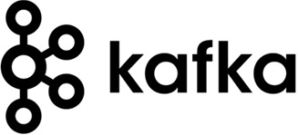
A Note on the Technologies
FYI
Order Read API
Order Read Core
Notes:
The messaging bus used was Kafka
For this project, just using a simple message stream, it didn’t really matter whether Kafka, RabbitMQ or Reddis was used
It’s worth noting the differences between RabbitMQ and Kafka
RabbitMQ uses a smart broker, dumb consumer model: it is the responsibility of the broker to deliver the right messages to the receiver. Supports complex routing, but persistence comes with performance penalty.
Kafka uses a dumb broker, smart consumer model: it is the responsibility of the consumer to remember where they have read to in a message stream. Most efficient broker for persisting messages.
With Kafka, messages can be persisted, then a subscriber who wasn’t even created when the message was stored can read the messages from the beginning. Although possible with RabbitMQ, it is not native.
For this reason, some people have recommended using Kafka as an Event Store.
However, this is not what it’s designed to do and it doesn’t support Optimistic Concurrency.

Slide 48
Triad Delivers
What’s Next?

Slide 49




What’s Next?
What Should I Have Done?
Notes:
A lot of the development effort comes from handling the request/response messaging and setting up infrastructure
VertX and Akka frameworks handle the internal messaging between components differently
AxonIQ and Lagom are frameworks built on top of the underlying technologies, and as such are much more opinionated in how you must implement your solution

Slide 50

Triad Delivers
Demonstration

Slide 51
Thank you
www.triad.co.uk

